Slide 1
Smart locker
Group-4
Lade Vivek 20BCE0432
Saratchandra Hemanth T 20BCE0510
Srikanth S 20BCE2343
Kagana Karthikeya 20BCE0490

Slide 2
Objective
To build a smart lock which reduces thefts and increases the safety. Building a smart lock with minimum cost and simple user interface . The user has to trigger the OTP generation and enter the OTP received to unlock the lock and if the user fails to do so in three attempts then the buzzer starts buzzing.

Slide 3
abstract
In our everyday lives, we use lockers to keep our valuables safe. Lockers with a lock and key are sometimes problematic, as humans, we tend to become lethargic to search for our key. Incidents occur where we lose our keys when need can't find them, we tend to panic. The agenda of our project is to design a smart lock which generates an OTP to the user when triggered and unlocks the lock only if the OTP is provided is the provided OTP is wrong a red LED starts glowing up for every wrong attempt and the user has three attempts to enter the correct OTP is the user fails to enter the correct OTP th buzzer starts buzzing and alerts the surroundings .

Slide 4
Existing system
Generally when it comes to locks people usually use a mechanical lock which can be easily accessed by a duplicate key and usually the locks won’t last more than 6 months and in general people won’t use a smart lock even if they want to, they are expensive and bit complicated for normal users.

Slide 5
Proposed system
We are implementing a smart lock using Arduino UNO and GSM module.
The user needs to trigger the OTP generation by pressing a particular push button then the OTP is generated and sent to the user’s mobile phone through SMS.
Then the users needs to enter the OTP received through Push buttons and if the entered OTP is correct then the door unlocks and a green LED starts glowing.
If the entered OTP is wrong a Red LED should glow and the LCD should show how many attempts are reaming.
If the user exceeds the wrong attempts then the buzzer should start buzzing and all the three LED will be glowing.

Slide 6
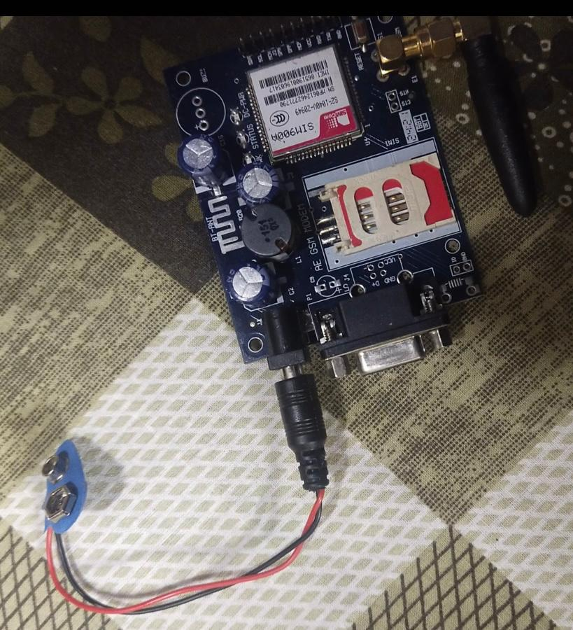
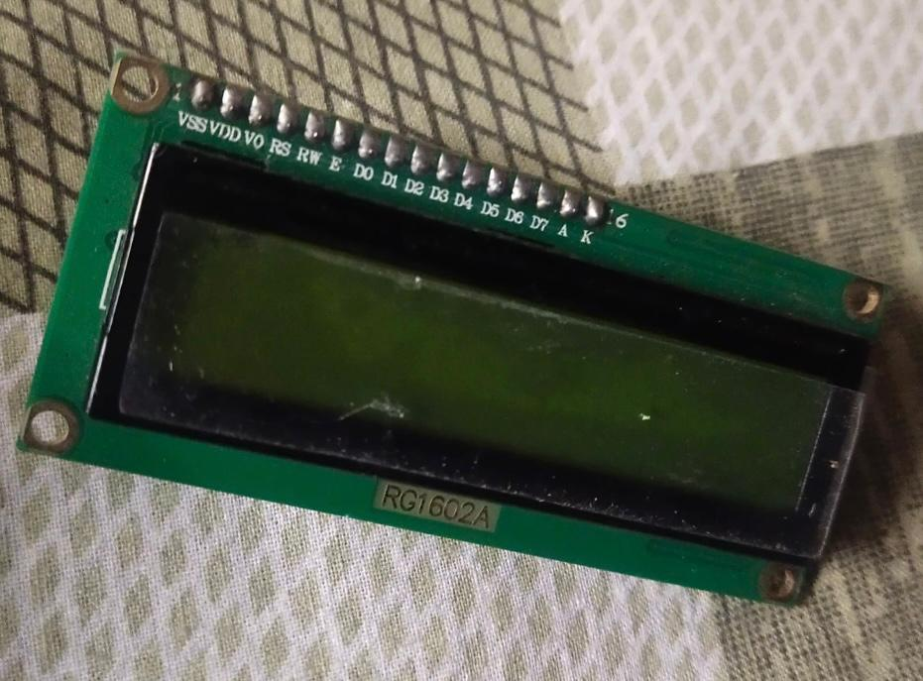
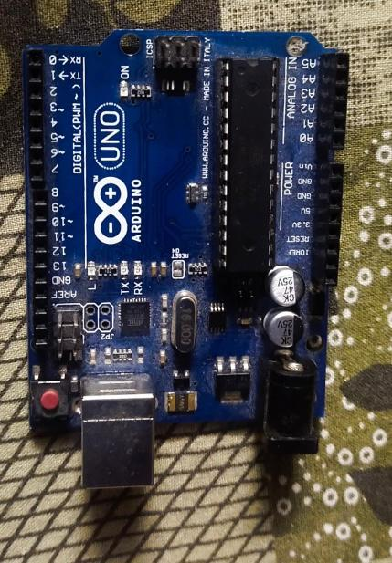
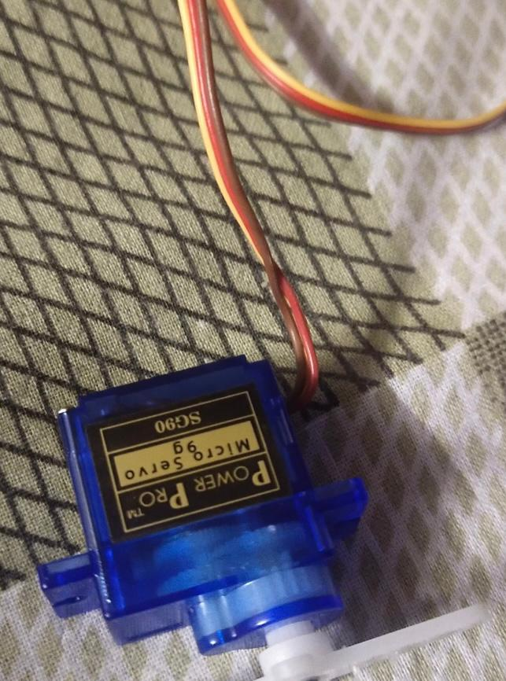
SOFTWARE AND HARDWARE REQUIREMENTS
Arduino UNO
GSM module
Breadboard
LCD
LEDs
Jumping Wires
Servo motor
Resistors
Buzzer
Battery
Push buttons

Slide 7
Arduino UNO
The Arduino Uno (Figure a) is a micro-controller board based on the ATmega328P. It has 14 digital input/output pins (of which 6 can be used as PWM outputs), 6 analog inputs, a 16 MHz quartz crystal, a USB connection, a power jack, an ICSP header and a reset button. It contains everything needed to support the micro controller; simply connect it to a computer with a USB cable or power it with a AC –DC adapter or battery to get started.

Slide 8
Global system for mobile communication (GSM)
Global system for mobile communication (GSM) is a globally accepted standard for digital cellular communication. GSM is the name of a standardization group establishedin1982tocreate a common European mobile telephone standard that would formulate specifications for a pan-European mobile cellular radio system operating at 900MHz. A GSM modem is a wireless modem that works with a GSM wireless network. A wireless modem behaves like a dial-up modem. The main difference between them is that a dial-up modem sends and receives data through a fixed telephone line while a wireless modem sends and receives data through radio waves. The working of GSM modem is based on commands, the commands always start with AT (which means ATtention) and finish with a character. For example, the dialling commands ATD; ATD3314629080; here the dialling command ends with semicolon. The AT commands are given to the GSM modem with the help of PC or controller. The GSM modem is serially interfaced with the controller with the help of MAX 232

Slide 9
16x2 LCD
The Serial LCDs are very functional, liquid crystal displays that can be easily interfaced to and controlled by a microcontroller using an I/O pin. The LCD displays provide basic text wrapping so that your text looks correct on the display. Full control over all of their advanced LCD features allows you to move the cursor anywhere on the display with a single instruction and turn the display on and off in any configuration. They support the same visible characters as the Terminal (ASCII Dec 32127). In addition, you may define up to eight of your own custom characters to display anywhere on the LCD. This device can be connected to a PC serial port using a MAX232 line driver. The circuit isn't supported by us.

Slide 10
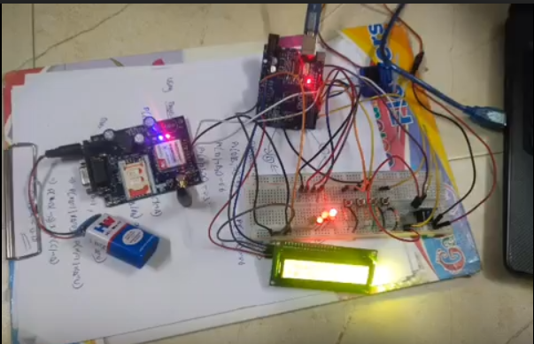
implementation

Slide 11
VIDEO LINK
https://drive.google.com/file/d/1FD1YBMYp2AHLYItrKbz0dey4d0OyhaQI/view?usp=share_link

Slide 12
References
Arduino Coding Basics - JavaTpoint
https://create.arduino.cc/projecthub/shafeekashraf44/otp-based-locker-e6bc8c
https://www.electronicsforu.com/electronics-projects/otp-based-smart-wireless-locking-system
How to Connect an LCD Display to Your Arduino | Arduino | Maker Pro
Interface GSM Module to Arduino - Send and Receive SMS (circuitstoday.com)
https://www.wellpcb.com/arduino-breadboard.html
Send SMS using a GSM module connected to Arduino (tutorialspoint.com)
How to Send Message from GSM Module using Arduino - (duino4projects.com)

